Slide 1
CROWDFUNDING
Making of One hands of many……

Slide 2
Crowd Funding
Crowd funding is the practice of funding a project or ventures by raising monetary contributions from a large no of people typically via internet.
According to the earliest recorded use of the word "crowdfunding" was by Michael Sullivan in fundavlog in August 2006.
Crowdfunding as a concept pre-dates the internet and projects like the Statue of Liberty raised funds from a large number of donors.

Slide 3
Why Crowd Funding?
Difficult In Raising Funds From Traditional Sources.
Test Market Or Establish User Base.
Marketing, Publicity For Your Product Or Services.
Faster Time To Market.
Funding.
Screening Device For Investors.
Access Greater Pool Of Investors, Further A Field Of People Without Right “Connections”.
Skills, Connections, And Other Sources.

Slide 4
Four forms of Crowdfunding
Donation based
Type: Donation
Benefit: Intangible benefits
Reward based
Type: Donation or prepurchase
Benefit: Reward in addition to Intangible benefits.
Equity based
Type: Investment
Benefit: Returns on investments if company performs well in future.
Type: Loan
Benefit: Repayment of loan with intrest or Intangible benefits if loan is given intrest free.
Debt based

Slide 5
Advantages
It Can Be A Fast Way To Raise Finance With No Upfront Fees.
Pitching A Project Or Business Through The Online Platform Can Be A Valuable Form Of Marketing And Result In Media Attention.
Sharing Your Idea, You Can Often Get Feedback And Expert Guidance On How To Improve It.
It Is A Good Way To Test The Public’s Reaction To Your Product/Idea - If People Are Keen To Invest It Is A Good Sign That The Your Idea Could Work Well In The Market.
Ideas That May Not Appeal To Conventional Investors Can Often Get Financed More Easily.
Your Investors Can Often Become Your Most Loyal Customers Through The Financing Process.

Slide 6
Crowdfunding Is A Powerful New Global Economy In 2013 Facebook and crowdfunding industry were neck & neck with Facebook grossing $5.97 billion in 2013 and crowdfunding industry grossing $5.1 billion in 2013 and now with crowdfunding reaching over 10 billion in 2014 it has out performed Facebook by billions.

Slide 7
About Project
CROWDFUNDING

Slide 8
What is “CROWDFUND”?
CROWDFUND is common platform that lets the Ideas meet the Funding's. Since every Spark needs the fuel to turn into a flame, the same way ideas need the funds to turn into a market share that’s what Our project Crowdfund comes in action by making the two ends meet (i.e. people with ideas and the people ready to invest).
“CROWDFUND” it is a reward based crowd funding web application.

Slide 9
Where are we in this crowd?
Got an Idea
Share it on Crowdfund
Pool of Investors
KICK START

Slide 10
Achitecture ( 3 Tiers )
Presentation
Bussiness logic
Data access
The Presentation Tier or User Interface is the portion the user sees when they open a web page in the browser.
Languages used in this layer are PHP, HTML, CSS and JavaScript.
The Business Logic, Functional Process Logic, Business Rules (all pertaining to the same thing), are kept in a separate layer.
In PHP, this is where you define your classes and source code.
In PHP, the Data Access layer is where you define your typed datasets and table adapters.
It is where you define your queries or stored procedures.

Slide 11
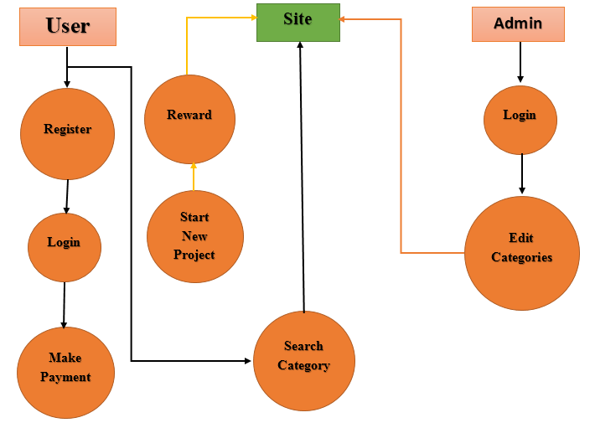
Data Flow Diagram
Mainly two types of Users:
Admin
User
Users further can:
Start a new Project for funding.
Or Fund an Exiting project.

Slide 12
Features

Slide 13
This system is very user friendly, we have no need to learn it first than work on it any person can easily access this system.
All the control is under the administrator and the other members have the rights to just see the records not to change any transaction or entry.
User Friendly
Efficiency
Control
Security
The basic need of this system is efficiency. The system should be efficient so that whenever a new user submits his\her details the system is updated automatically.
Security is the main criteria for the proposed system. Since illegal access may corrupt the data base. So security has to be given in this project.

Slide 14
Some Sample Images

Slide 15
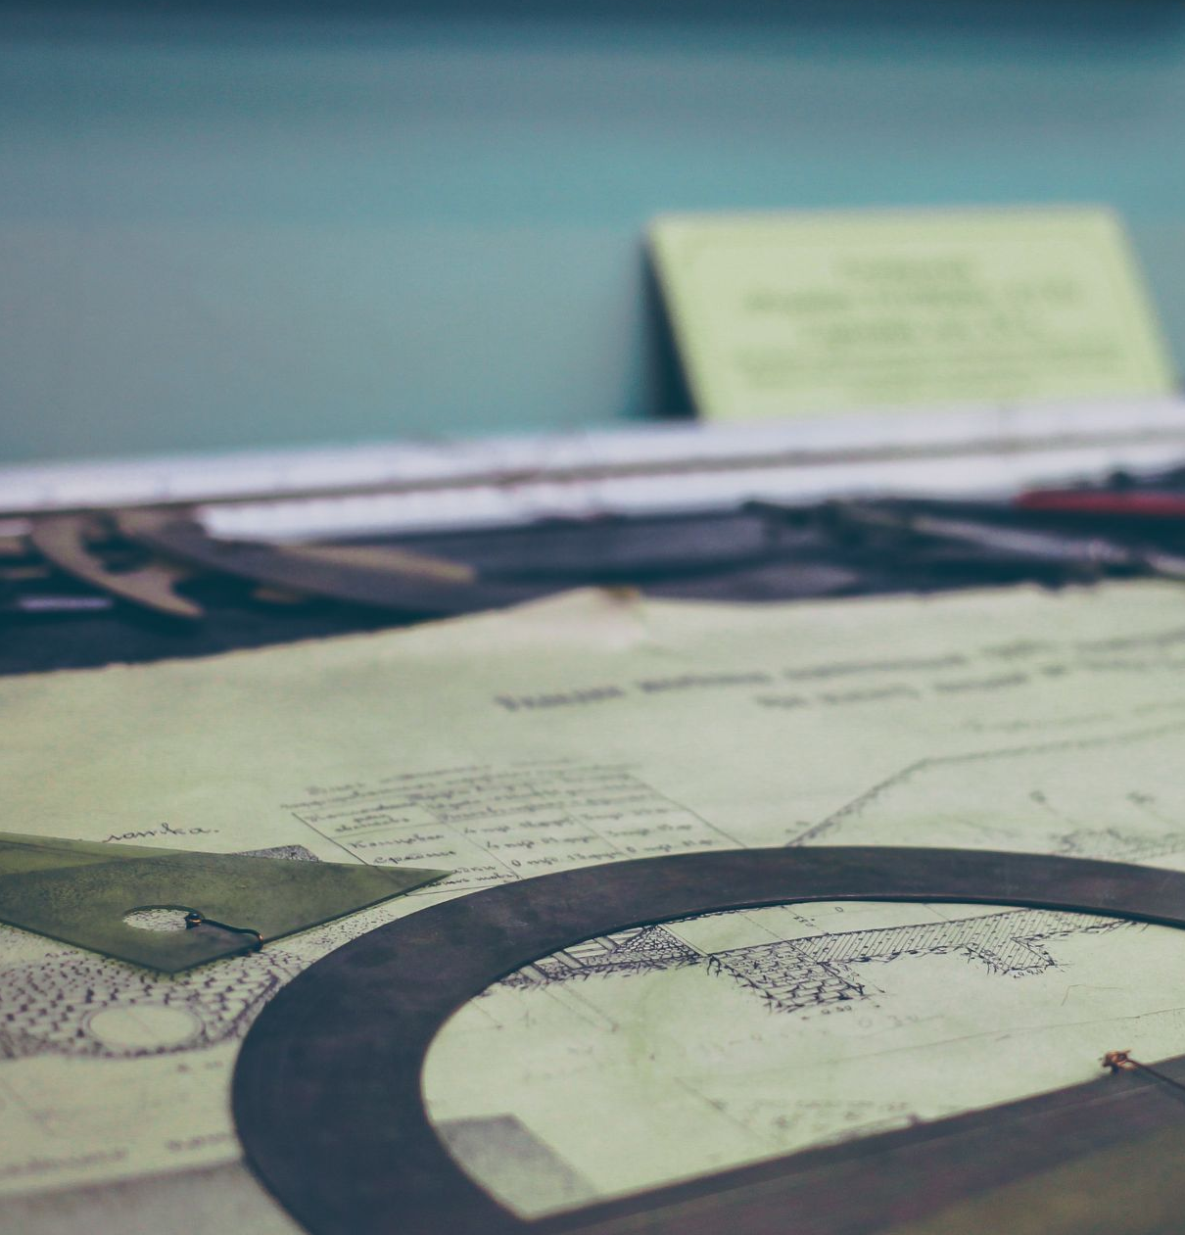




Slide 16
Software Designing Life Cycle

Slide 17
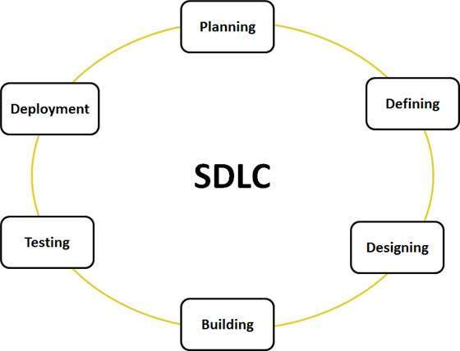
Introduction
Systems Development Life Cycle (SDLC) is a conceptual model.
Its used in project management that describes the stages involved in an information system development project from an initial feasibility study through maintenance of the completed application.
Various SDLC methodologies have been developed to guide the processes involved.

Slide 18
Requirement analysis is the most important and fundamental stage in SDLC.
Based on the requirements specified in SRS, and DDS is made.
Testing of the application is performed to check the quality.
Planning
Defining
Design
Development
Testing
Maintanance
SRS document is made defining all the requirements and features.
Actual development starts and the product is built.
Maintenance of the product is done after deployment.

Slide 19
Planning and Requirement Analysis
Requirement analysis is the most important and fundamental stage in SDLC.
Made with inputs from the customer, the sales department, market surveys and domain experts in the industry.
This information is then used to plan the basic project approach and to conduct product feasibility study in the economical, operational, and technical areas.
Planning for the quality assurance requirements and identification of the risks associated with the project is also done in the planning stage.

Slide 20
Defining Requirements
Once the requirement analysis is done the next step is to clearly define and document the product requirements and get them approved from the customer or the market analysts.
This is done through SRS.
Software Requirement Specification document which consists of all the product requirements to be designed and developed during the project life cycle.

Slide 21
Designing the product architecture
SRS is the reference for product architects to come out with the best architecture for the product to be developed.
Based on the requirements specified in SRS, usually more than one design approach for the product architecture is proposed and documented in a DDS - Design Document Specification.
A design approach clearly defines all the architectural modules of the product along with its communication and data flow representation with the external and third party modules (if any).

Slide 22
Building or Developing the Product
In this stage of SDLC the actual development starts and the product is built.
The programming code is generated as per DDS during this stage.
If the design is performed in a detailed and organized manner, code generation can be accomplished without much hassle.
The programming language is chosen with respect to the type of software being developed.

Slide 23
Testing the Product
This stage is usually a subset of all the stages as in the modern SDLC models, the testing activities are mostly involved in all the stages of SDLC.
Refers to the testing only stage of the product where products defects are reported, tracked, fixed and retested, until the product reaches the quality standards defined in the SRS.

Slide 24
Deployment in the Market and Maintenance
Once the product is tested and ready to be deployed it is released formally in the appropriate market.
Sometime product deployment happens in stages as per the organizations business strategy.
Based on the feedback, the product may be released as it is or with suggested enhancements in the targeting market segment.

Slide 25
Prototype Model
Used in CROWDFUNDING

Slide 26
Intro To Protype Model
Prototype is a working model of software with some limited functionality.
The prototype does not always hold the exact logic used in the actual software application and is an extra effort to be considered under effort estimation.
Prototyping is used to allow the users evaluate developer proposals and try them out before implementation.
It also helps understand the requirements which are user specific and may not have been considered by the developer during product design.

Slide 27
STEPWISE APPROACH IN PROTOTYPE MODEL AND HOW WE USED IT IN OUR PROJECT

Slide 28
Basic Requirement Identification
This step involves understanding the very basics product requirements especially in terms of user interface.
In our project we too identify the basic requirements that we need like the availability of the drop box’s in User Interface to ease the categorization and the important fields the user will need to start a new project.
Further more identification was done for the project.

Slide 29
Developing the initial Prototype
The initial Prototype is developed in this stage, where the very basic requirements are showcased and user interfaces are provided.
In our project we first made the basic prototype that provides the basic functionality of an crowd funding websites, in which a user can login/signup and further start a new project.

Slide 30
Review of the Prototype
The prototype developed is then presented to the customer and the other important stakeholders in the project.
We reviewed our application on local machine and tested all the functionalities that we have implemented, after successful and satisfactory results of testing the application and reviewing the implemented functionality we moved to next step of Prototype model.

Slide 31
Revise and enhance the Prototype
The feedback and the review comments are discussed during this stage and new prototype with these new changes new prototype are made.
After reviewing and feedback from various other people and under the guidance we further added the requested features like use of categorization and allow the user to search though the categories.

Slide 32
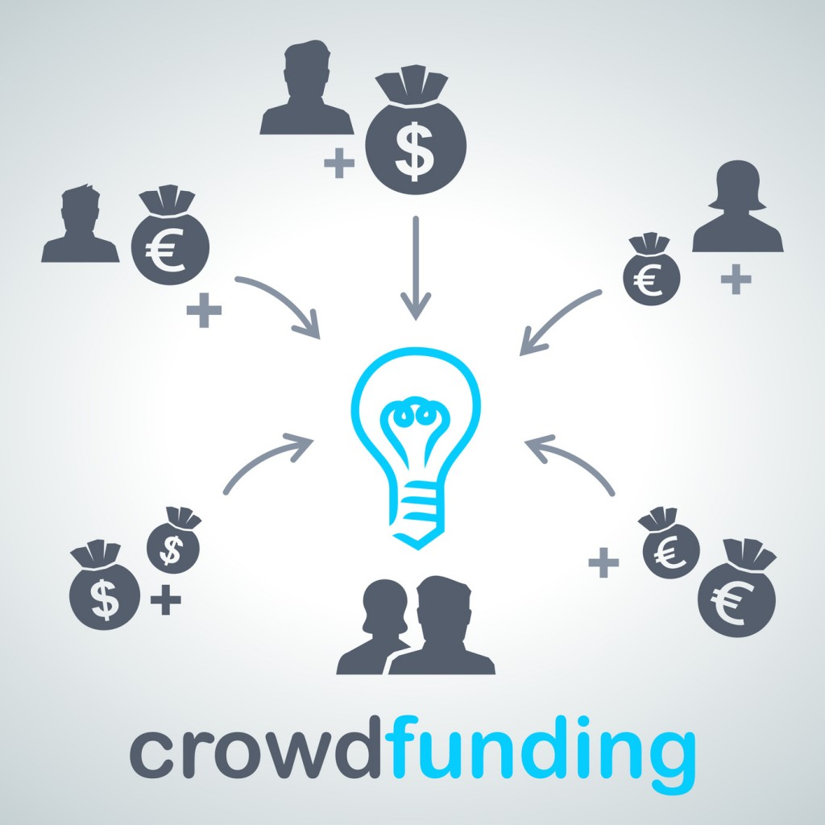
THANK YOU!!
Made By:
Komal
Sweta Gupta

